Slide 1
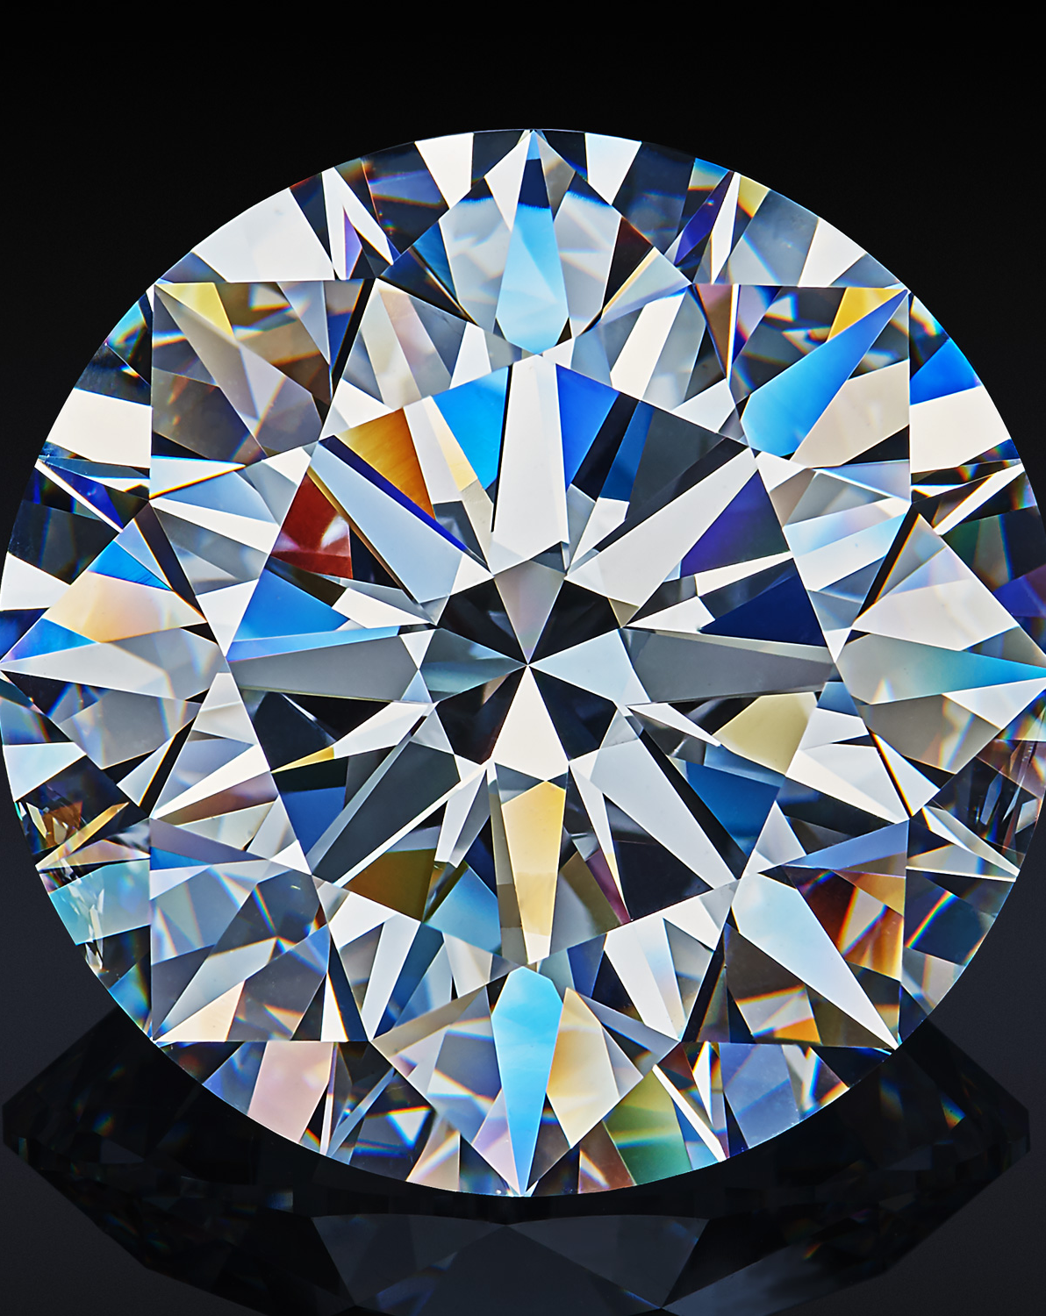
The Professor Proposes
Team - 1
Notes:
To change the image on this slide, select the picture and delete it. Then click the Pictures icon in the placeholder to insert your own image.

Slide 2
Problem Statement
The diamond should be within a range of 2000 to 4000 Canadian dollar according to his budget but the problem he faced when he arrived at the diamond shop are highlighted below:
Higher the carat of diamond makes the price of diamond higher i.e. big diamonds are rare which increased the value of the diamond.
The quality and price of diamond depends upon cut, clarity, polish, symmetry and color.
Different colored diamond are rare to find which increases the value of colorful diamond and made them expensive. Although colorless diamonds are placed with discounts if there is a presence of small yellowish spot.

Slide 3
Professor’s Requirement
Characteristics | Values
Carat Weight | 0.9
Cut | Very Good
Color | J
Clarity | SI2
Polish | Good
Symmetry | Very Good
Certification | GIA
Quoted Price: $3,100

Slide 4
Variables Set
Price is taken as a dependent variable, since price is derived from different characteristics of the diamond. Cut, color, clarity and carat are taken as the independent variable.
Another requirement was to use color and clarity as dummy variables, which only take the value of 0 or 1. We also used cut as a dummy variable for developing the model. The conditions were set according to the professor’s preference which are as follows:
Clarity will take the value 1 when its scale is SI2, otherwise for all other conditions it will take a value of 0.
Color will take the value 1 when its scale is “J”, otherwise for all other conditions it will take a value of 0.
Cut will take the value 1 when its scale is “very good”, otherwise for all other conditions it will take a value of 0.

Slide 5
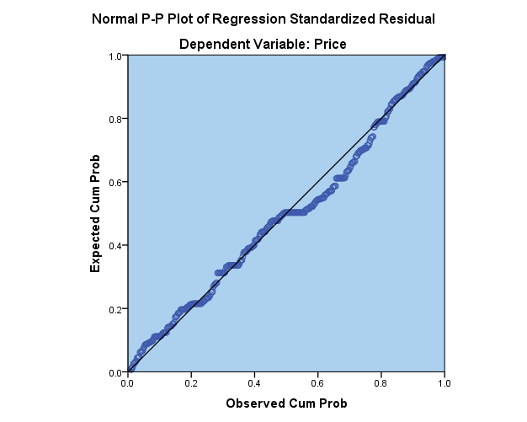
Regression
Linear regression was the method which was used to regress the independent variables against the dependent variable.
This method was considered after plotting the data, we can easily see that a straight line fits through the data with minimum squared errors. So, a linear regression model was the best choice.

Slide 6
Descriptive Analysis
The number of observation for each variable is 440. The data used for analysis consist of all three vendors/wholesalers combined. The descriptive statistics are as follow:
 | Mean | Std. Deviation | N
Price | 1716.74 | 1175.689 | 440
Carat | .6692 | .37980 | 440
Color_Dummy | .23 | .424 | 440
Clarity_Dummy | .25 | .434 | 440
Cut_Dummy | .22 | .415 | 440

Slide 7
Correlation
Correlations
 |  | Price | Carat | Color_Dummy | Clarity_Dummy | Cut_Dummy
Pearson Correlation | Price | 1.000 | .925 | .112 | .127 | -.244
 | Carat | .925 | 1.000 | .175 | .012 | -.328
 | Color_Dummy | .112 | .175 | 1.000 | -.009 | -.035
 | Clarity_Dummy | .127 | .012 | -.009 | 1.000 | .035
 | Cut_Dummy | -.244 | -.328 | -.035 | .035 | 1.000
Sig. (1-tailed) | Price | . | .000 | .009 | .004 | .000
 | Carat | .000 | . | .000 | .398 | .000
 | Color_Dummy | .009 | .000 | . | .423 | .232
 | Clarity_Dummy | .004 | .398 | .423 | . | .233
 | Cut_Dummy | .000 | .000 | .232 | .233 | .
N | Price | 440 | 440 | 440 | 440 | 440
 | Carat | 440 | 440 | 440 | 440 | 440
 | Color_Dummy | 440 | 440 | 440 | 440 | 440
 | Clarity_Dummy | 440 | 440 | 440 | 440 | 440
 | Cut_Dummy | 440 | 440 | 440 | 440 | 440

Slide 8
Model Summary
Model Summary^{b}
Model | R | R Square | Adjusted R Square | Std. Error of the Estimate | Change Statistics |  |  |  |  | Durbin-Watson
 |  |  |  |  | R Square Change | F Change | df1 | df2 | Sig. F Change
1 | .936ª | .876 | .875 | 416.492 | .876 | 765.784 | 4 | 435 | .000 | .474
a. Predictors: (Constant), Cut_Dummy, Clarity_Dummy, Color_Dummy, Carat
b. Dependent Variable: Price

Slide 9
Coefficients
Coefficientsª
Model |  | Unstandardized Coefficients |  | Standardized Coefficients | t | Sig. | 95.0% Confidence Interval for B
 |  | B | Std. Error | Beta |  |  | Lower Bound | Upper Bound
1 | (Constant) | -341.343 | 47.831 |  | -7.136 | .000 | -435.352 | -247.333
 | Carat | 2952.297 | 56.269 | .954 | 52.467 | .000 | 2841.704 | 3062.890
 | Cut_Dummy | 179.073 | 50.759 | .063 | 3.528 | .000 | 79.309 | 278.837
 | Color_Dummy | -142.004 | 47.641 | -.051 | -2.981 | .003 | -235.639 | -48.370
 | Clarity_Dummy | 304.083 | 45.900 | .112 | 6.625 | .000 | 213.869 | 394.297
a. Dependent Variable: Price
In accordance with the obtained results the regression model created is as follow,
Y = -341.343 + 2952.297X + 179.073X2 - 142.004X3 + 304.083X4

Slide 10
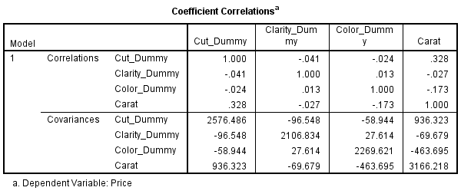
Coefficient Correlation

Slide 11
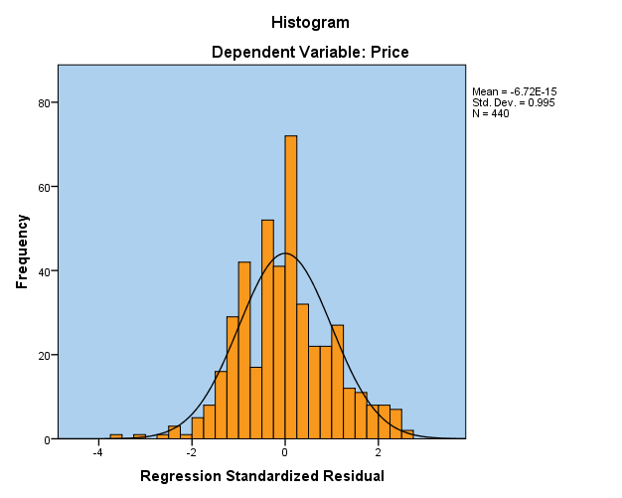

Regression Standardized Residual
The data is distributed symmetrically which means that it is distributed equally.
The data is skewed in the right direction indicating that most of the data is positive.
The data also shows that there are outliers presented in the data which indicates these outliers are affecting the mean of the data which could generate ambiguity in analyzing the data.

Slide 12
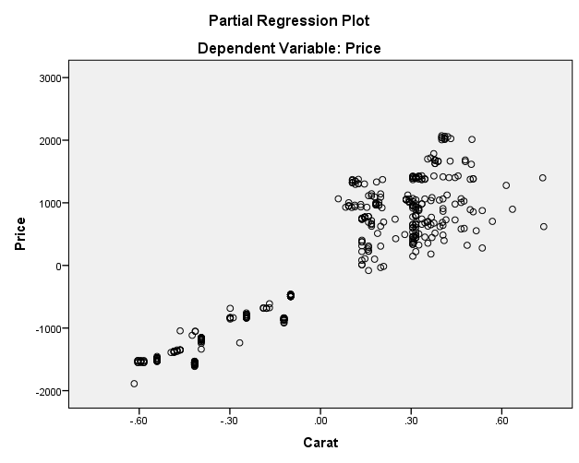
RELATIONSHIP BETWEEN PRICE AND CARAT
The partial regression scatter plot diagram for the regression equation formulated indicates that
when the carats of the diamond increases,
the price of the diamonds also increases i.e. the more the carat the higher the price of the diamond.

Slide 13
Final Run
Constant | X | X₂ | X₃ | X₄
-341.343 | 2952.297 | 179.073 | -142.004 | 304.083
X₁ = | 0.9
X₂ = | 1
X₃ = | 1
X₄ = | 1
Price = | 2656.876

Slide 14
Conclusion
Therefore, according to the model the professor should get the diamond for about $2,656.87.

